Slide 1
Weather RESTFul Web Service
By:
Arel Gindos
Niv Baruch

Slide 2
About
Our library add to your program an ability to get an online weather data about any country and city in the world.
Simple is beautiful.
All you need to do is add our library.
After that you can use it for free.
We are doing everything for you.
You have to make sure you have an internet connection.
The library GitHubPage: http://niv90.github.io
YouTube tutorial: https://www.youtube.com/watch?v=1MvAuUYTcUI

Slide 3
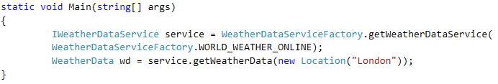
Instructions
1. Download our library from:
https://github.com/niv90/CSharpWeatherData.git
2. Add it to your program.
3. Add this lines to your code:
IWeatherDataService service =
WeatherDataServiceFactory.getWeatherDataService(
WeatherDataServiceFactory.WORLD_WEATHER_ONLINE);
You can choose from 2 RESTFul Web Service:
www.worldweatheronline.com or www.openweathermap.com
All you have to do is change the static value inside the getWeatherDataService( Const Service ).
4. Add this line to your code:
WeatherData wd = service.getWeatherData(new Location(“YourCountry"));

Slide 4
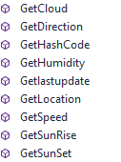
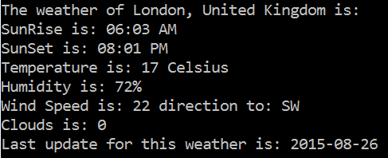
Results
You are done, you can use the Get functions to get data.
If you want print to the console all the details about
The country / city entered, choose: wd.PrintAllDetails();
* You must be connected to the internet in order to use this service.

